Slide 1

Multi-object detection
EE19B010-Niranjan
EE19B025-Sakethram

Slide 2
Introduction
The main goal of multi-object tracking(MOT) is to follow paths or trajectories of multiple targets in a sequence.
Multiple object tracking is a field of computer vision that has a wide range of applications, starting from video surveillance and human-computer interaction to robotics.

Slide 3
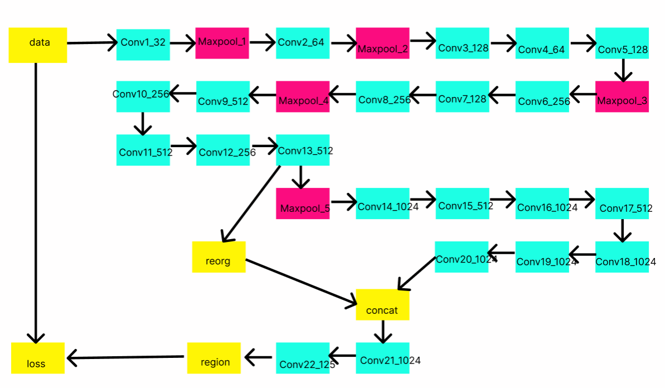
Architecture
YOLO Architecture

Slide 4
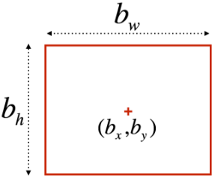

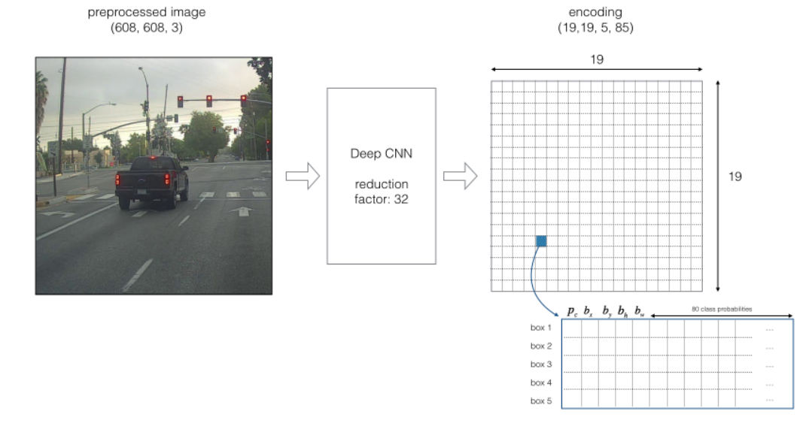
YOLO Architecture
Basic representation of vector in YOLO algorithm.
Encoding

Slide 5
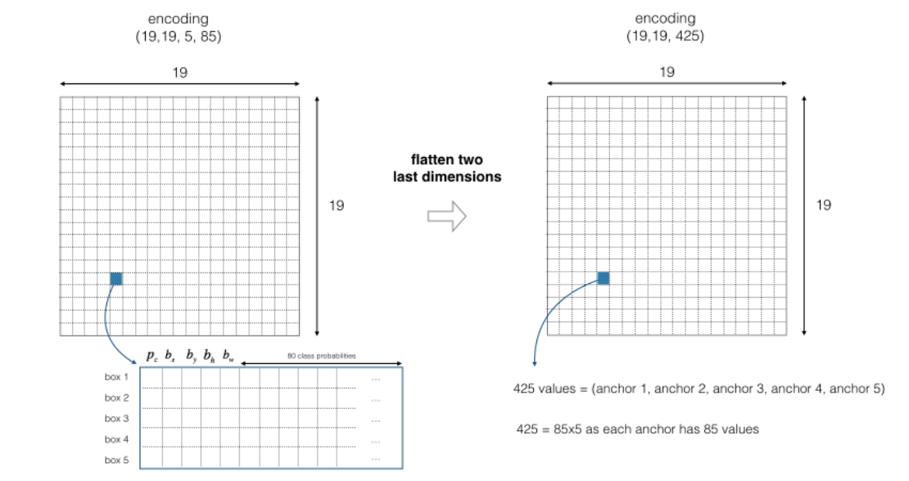

Slide 6
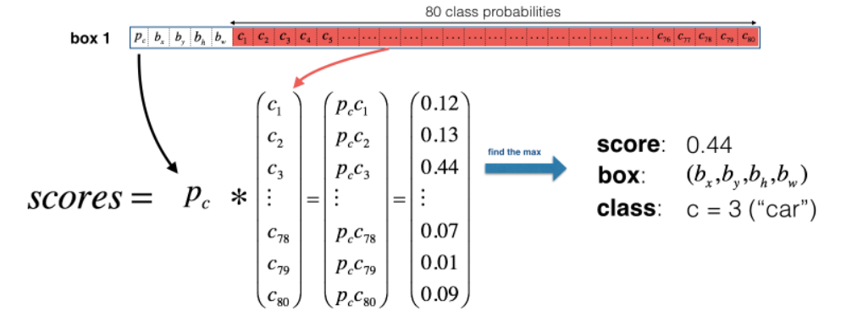
Methodology
Filtering by thresholding class scores.
Filtering by non-max suppression.
Class scores

Slide 7
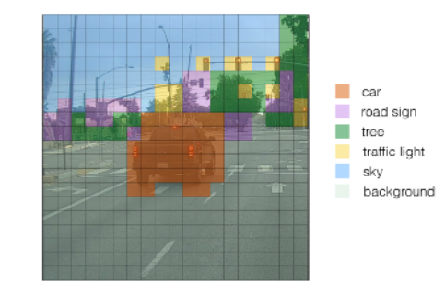
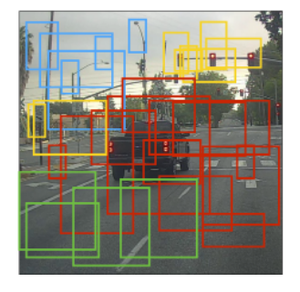
The two ways of visualizing classes,

Slide 8
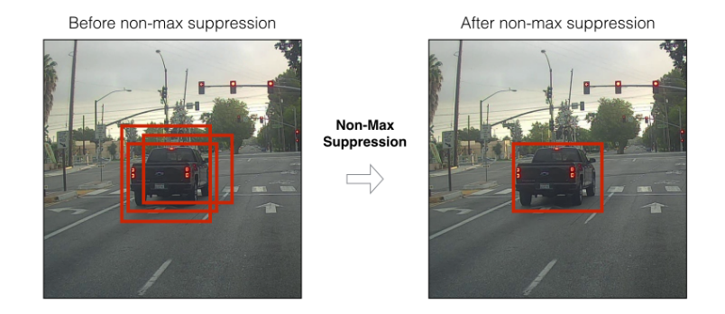
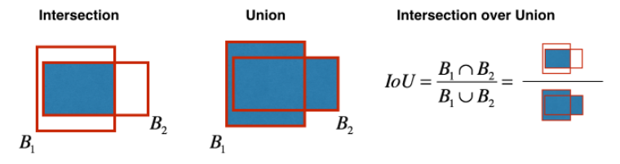
Non-max suppression,
Intersection of Union,

Slide 9
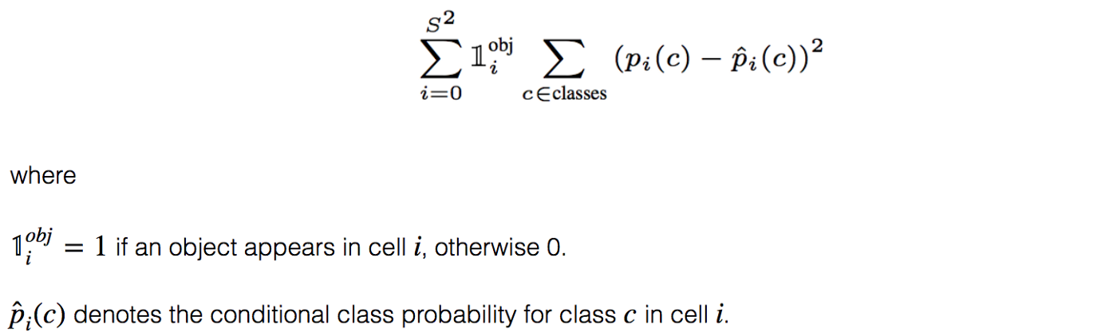
Cost Function
Classification loss

Slide 10
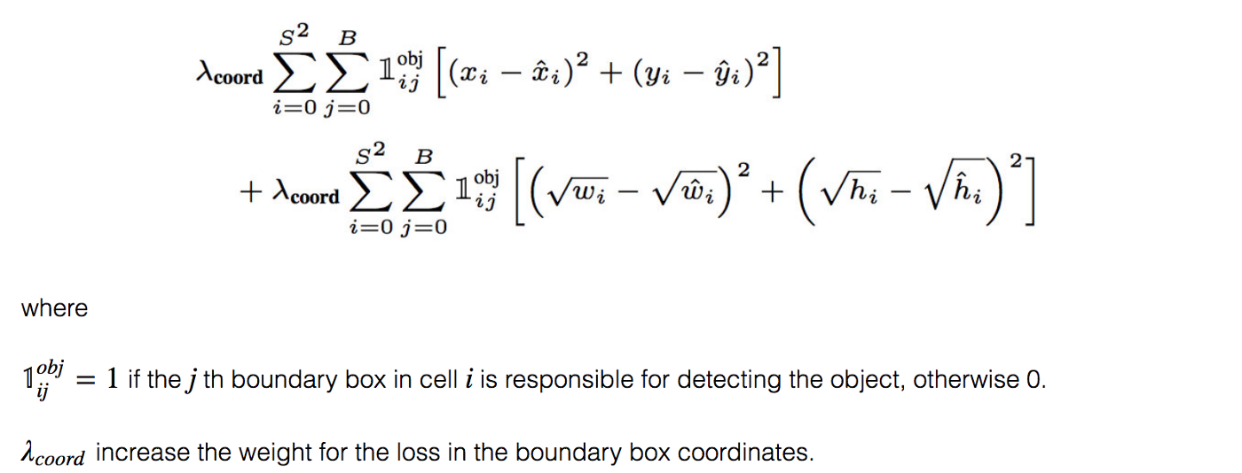
Cost Function
Localization loss(errors between the predicted boundary box and the ground truth).

Slide 11
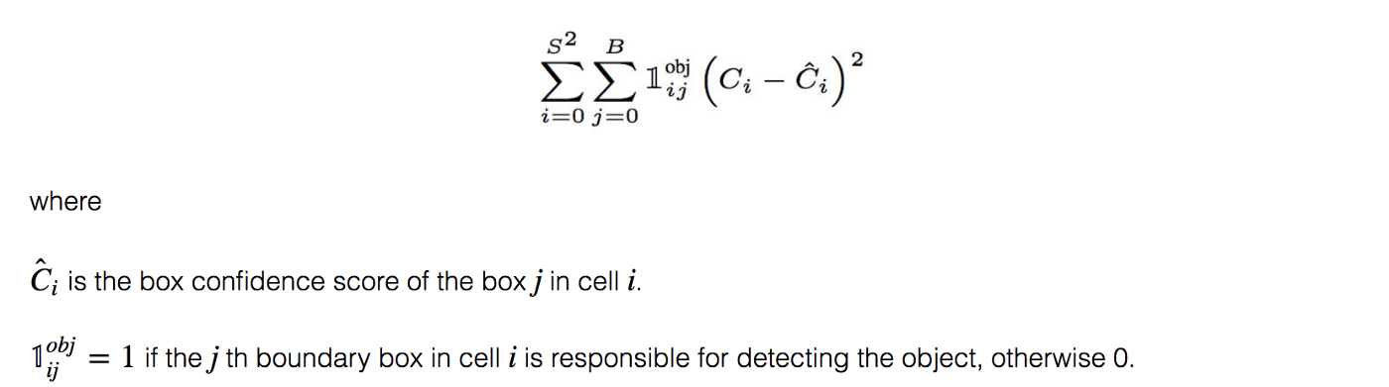
Cost Function
Confidence loss

Slide 12
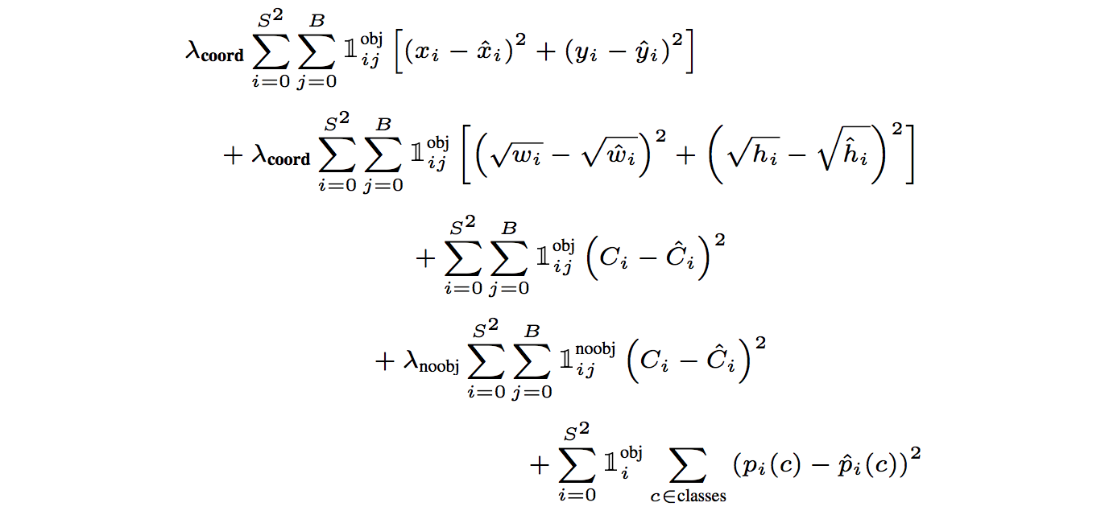
Cost Function
Total Loss

Slide 13

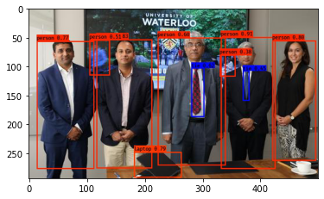
Output Result

Slide 14
THANK YOU

